Slide 1
Project 4
Dhruvin Patel

Slide 2
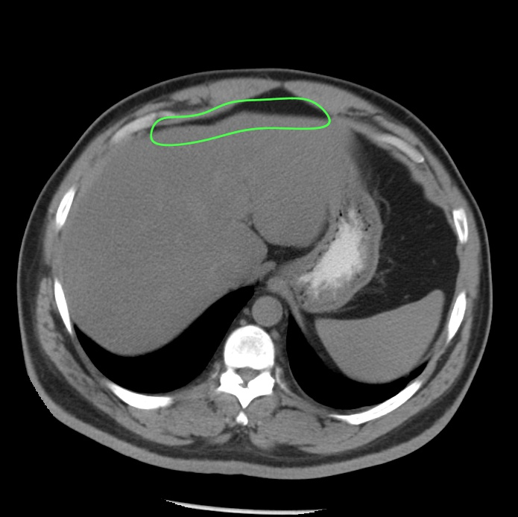

Preprocessing Images
Create a mask with the area in the green line
Black out the background
Crop around the mask

Slide 3

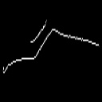
Preprocessing Images
Remove green line
Apply a Gaussian Blur
Denoise the image
Apply Canny edge detection with varying thresholds
Resize the image to 128 x 128

Slide 4
Preprocessing Images
Spilt the preprocessed image into training, validation, and test set
60% Training
20% Validation
20% Test

Slide 5
Classifier
Using Keras library to create a CNN
Convolution images with 32 3x3 filters
Max Pooling with 2x2 window
Repeat Convolution and Pooling
Flatten and dense the network
Apply sigmoid activation to get probability
Using Adam for optimizer and cross entropy for loss

Slide 6
Results
Train and Validation
97%
Testing
99%

Slide 7
Questions?

